Slide 1
RNFL-VA Correlations
for individuals with two “normal” eyes
Adam Shah

Slide 2
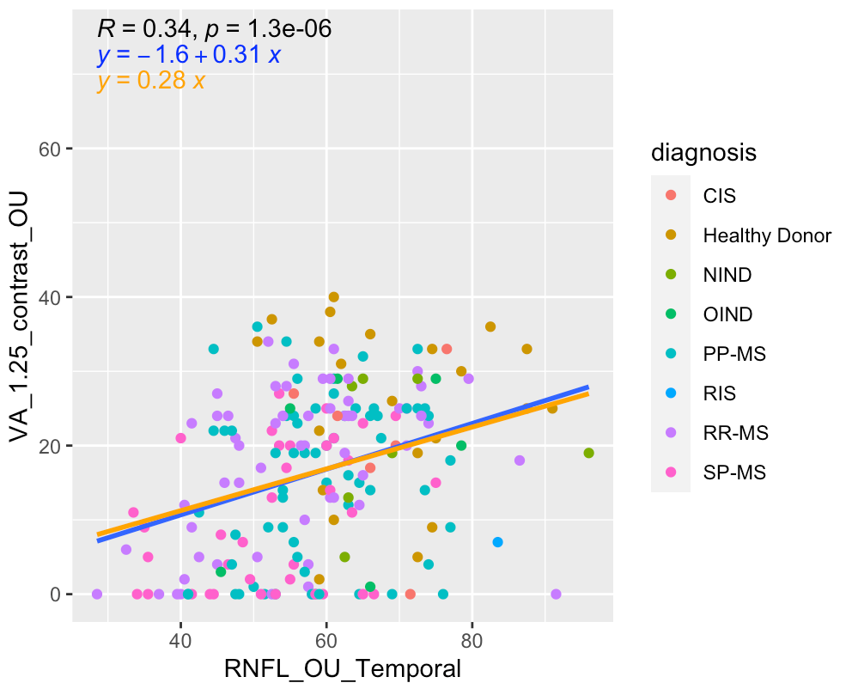
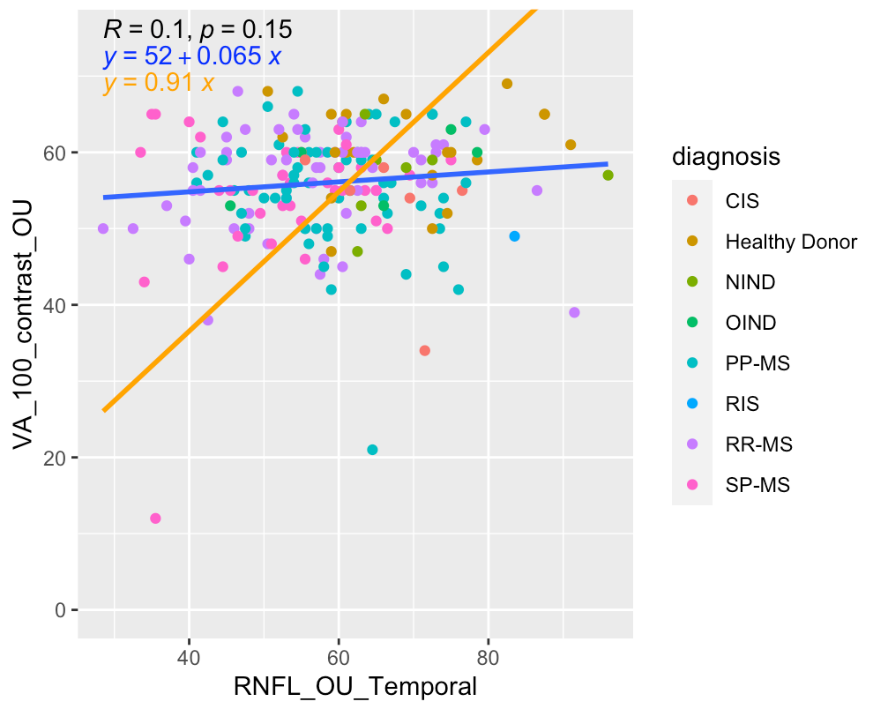
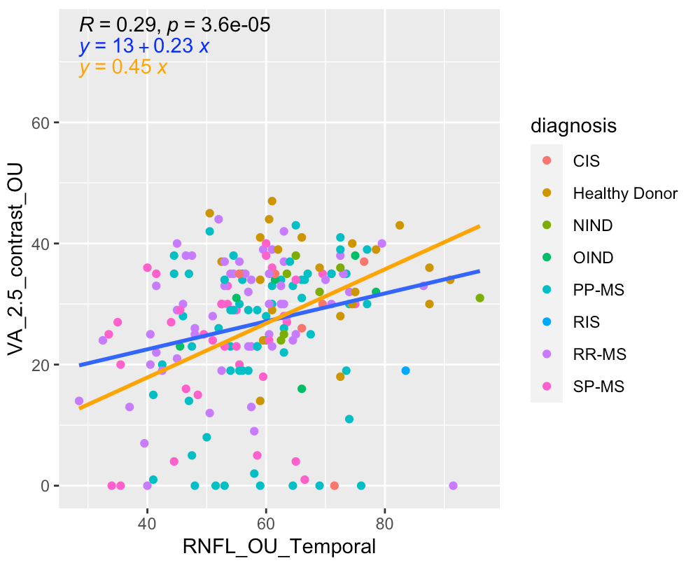
Temporal
*blue line represents normal linear
regression, orange represents
regression through the origin
(I wasn’t sure which was appropriate
in this case)

Slide 3
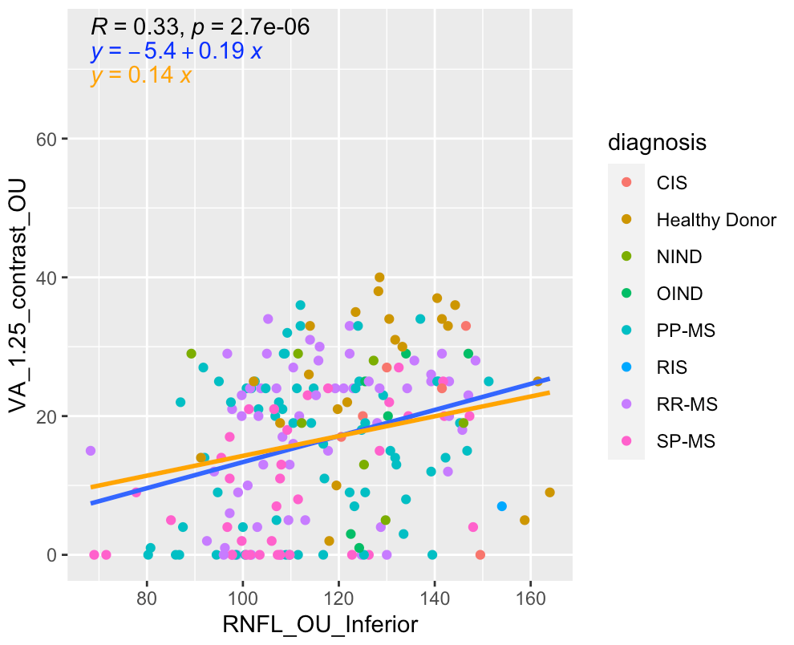
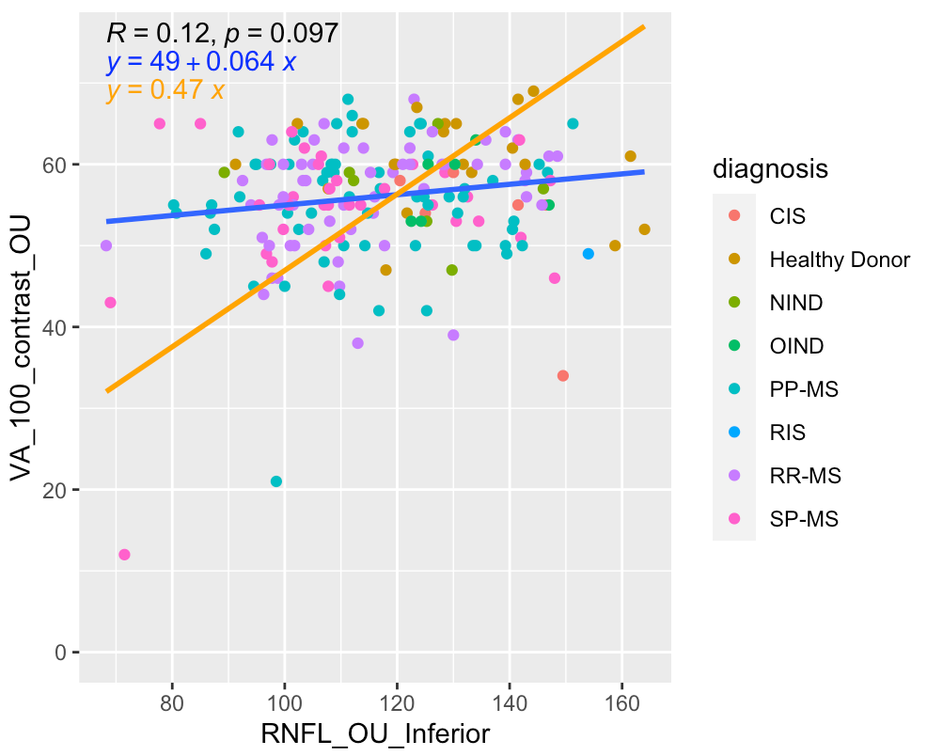
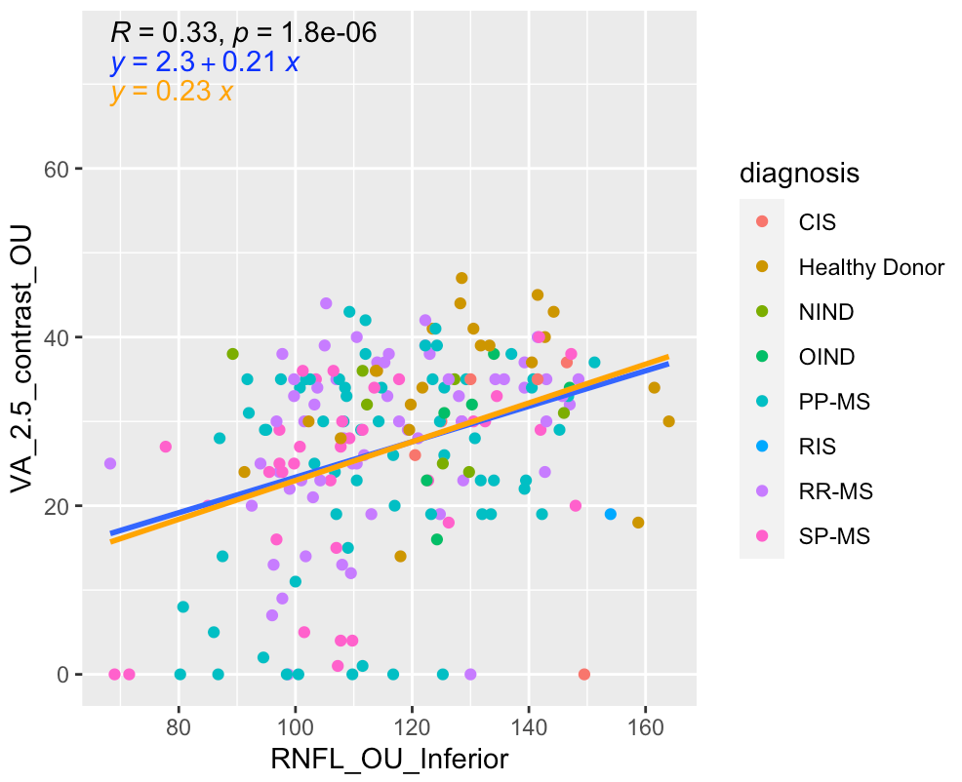
Inferior

Slide 4
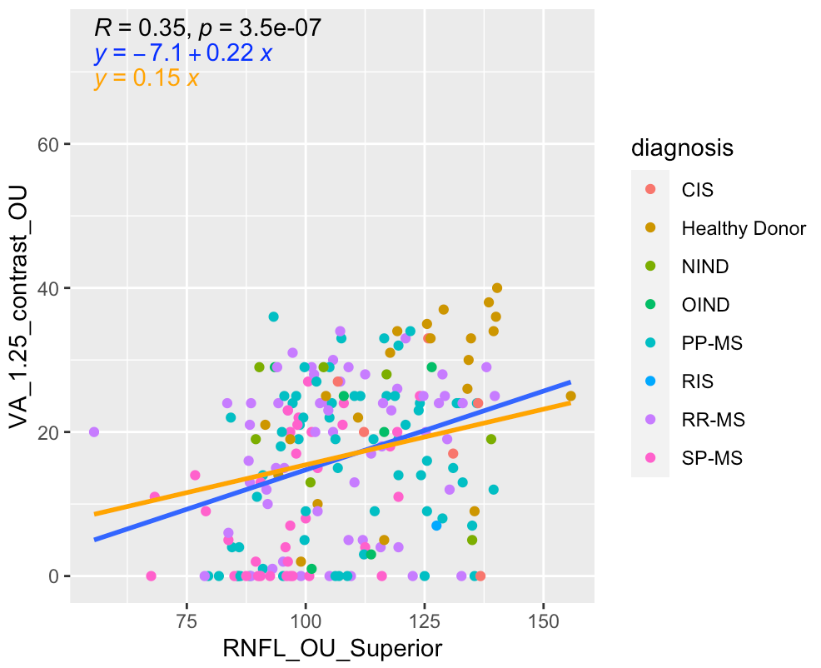
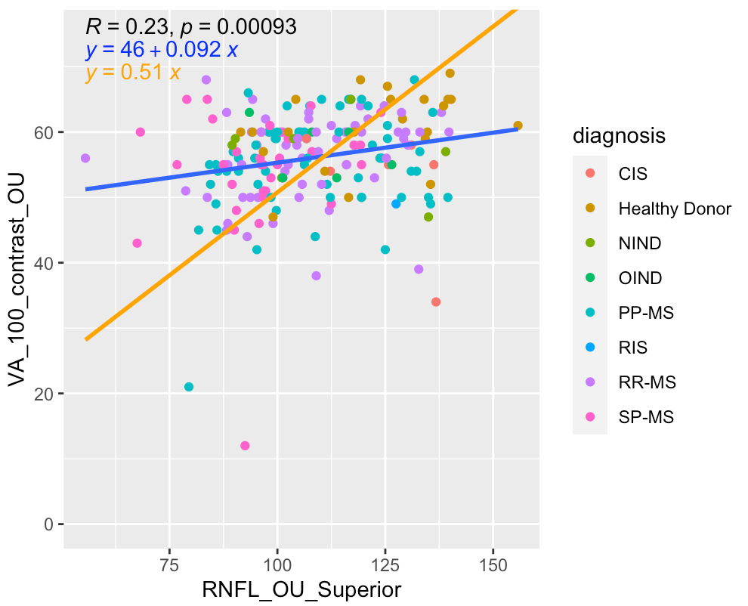
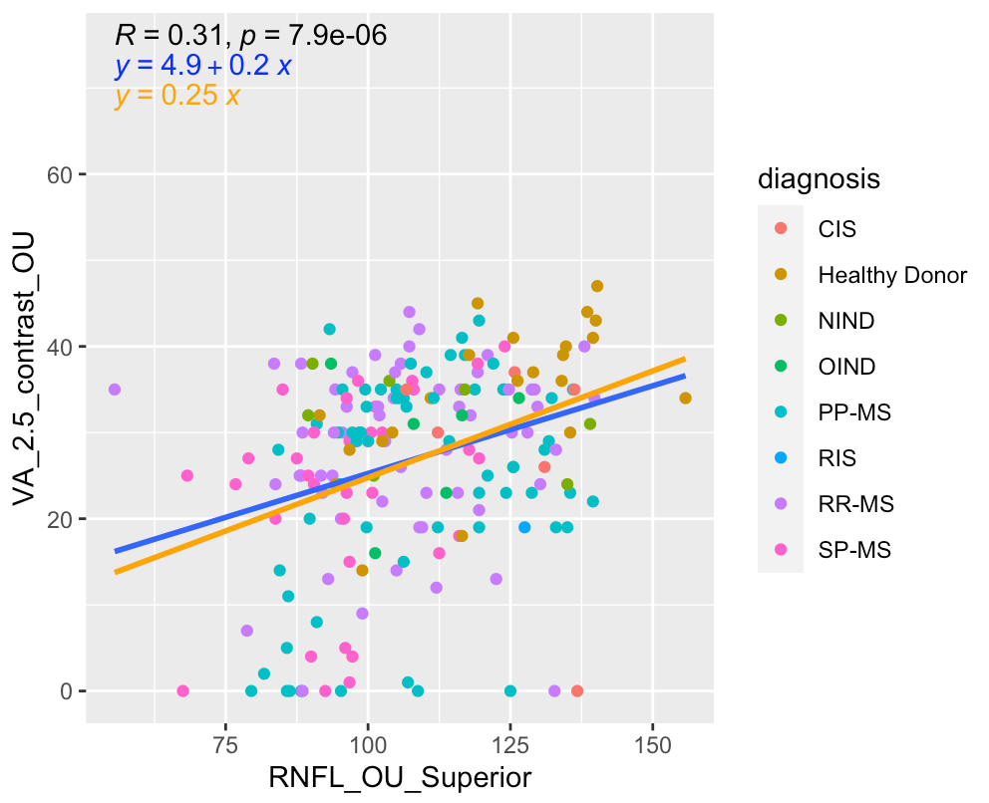
Superior

Slide 5
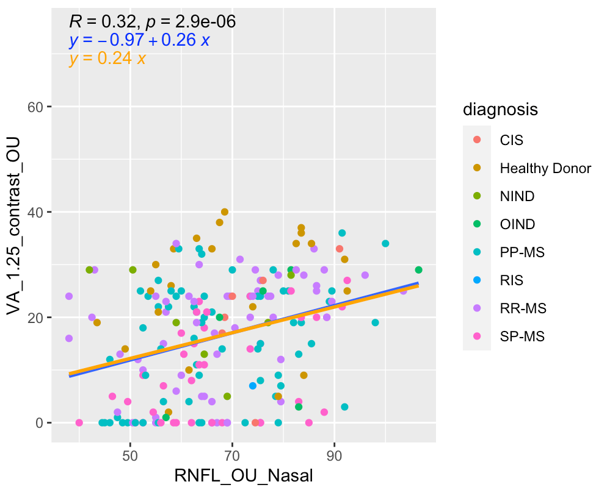
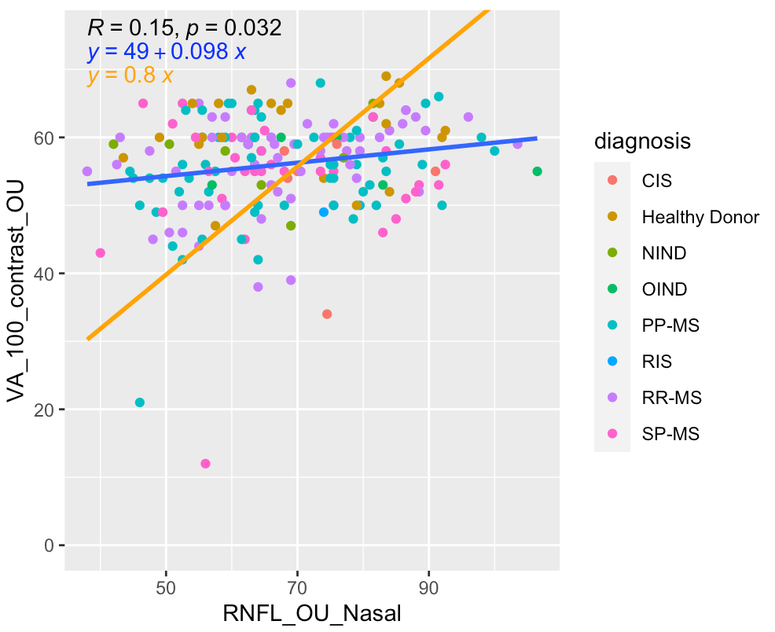
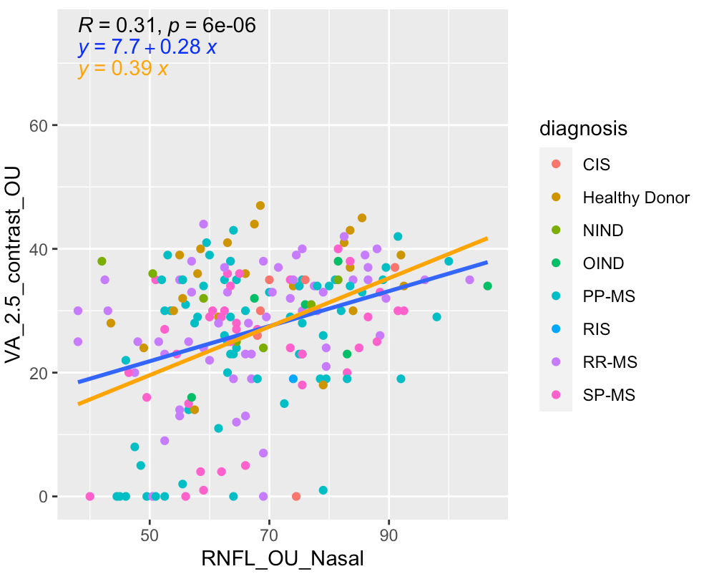
Nasal

Slide 6
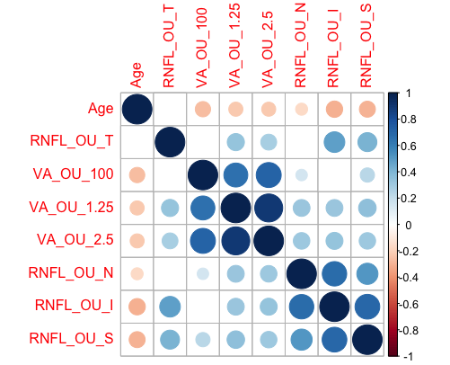
Correlation matrix w/ all RNFL regions, VA outcomes and age
*blanks represent p-value > 0.05

Slide 7
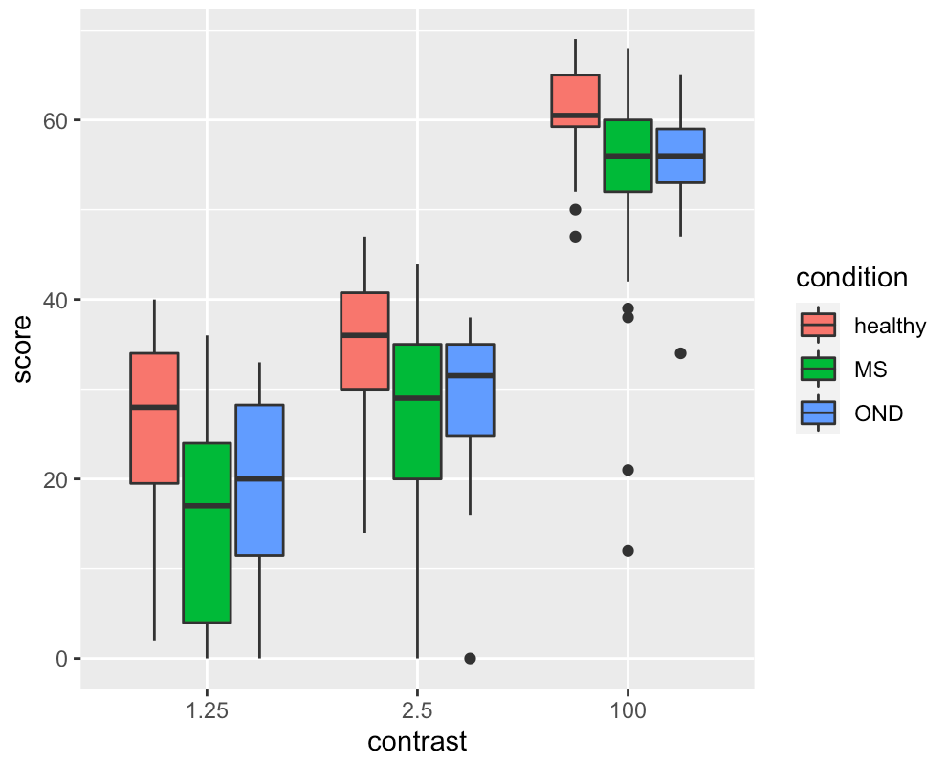
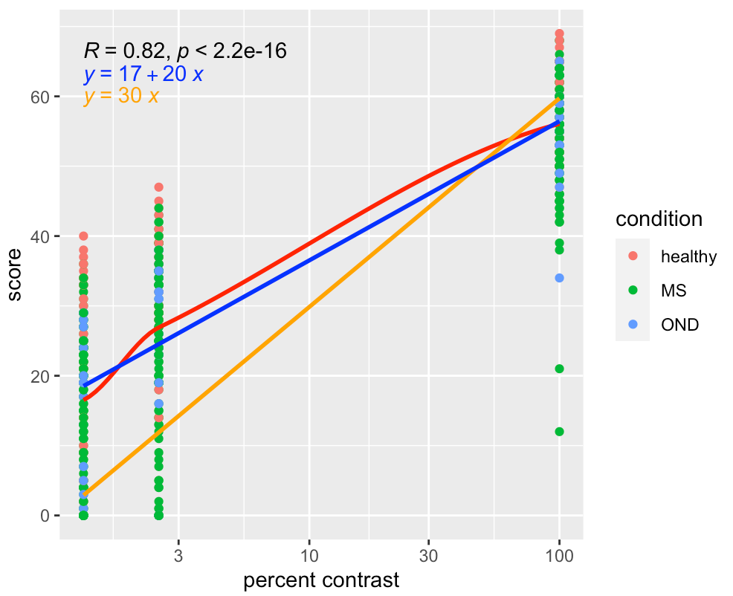
Plots for 3-contrast VA scores
*I might need some help with this; I was trying to replicate the theoretical plot
for VA score vs. percent contrast with a logarithmic scale. Blue is normal linear
regression, orange is regression through the origin, and red is a moving average.

